Slide 1


FIT9136 PASS WEEK 4
Introduction to Functions, Scoping, Debugging
12th Aug 2024
CL_33 Innovation Walk, Room C107

Slide 2

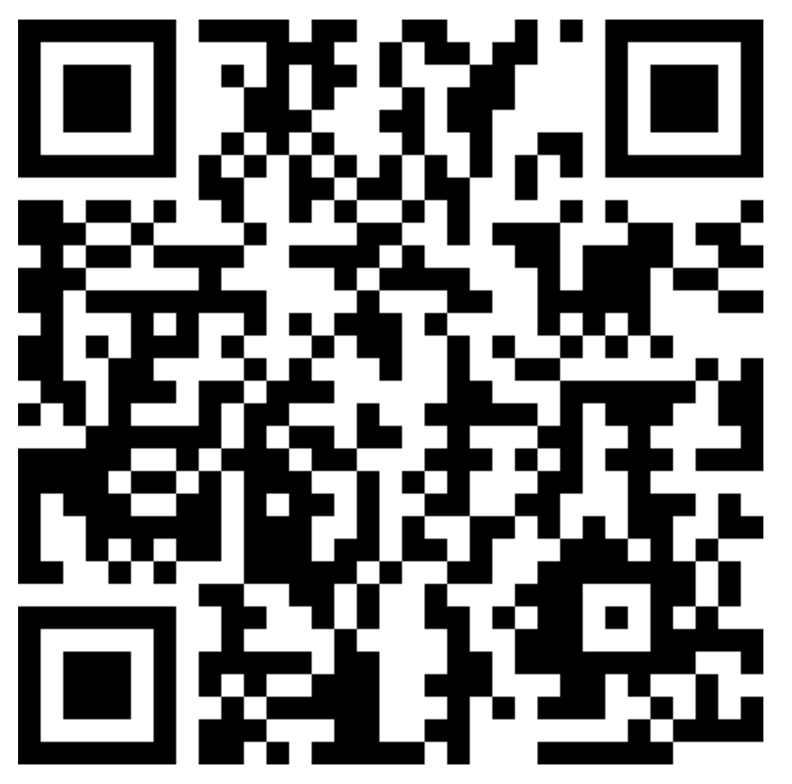
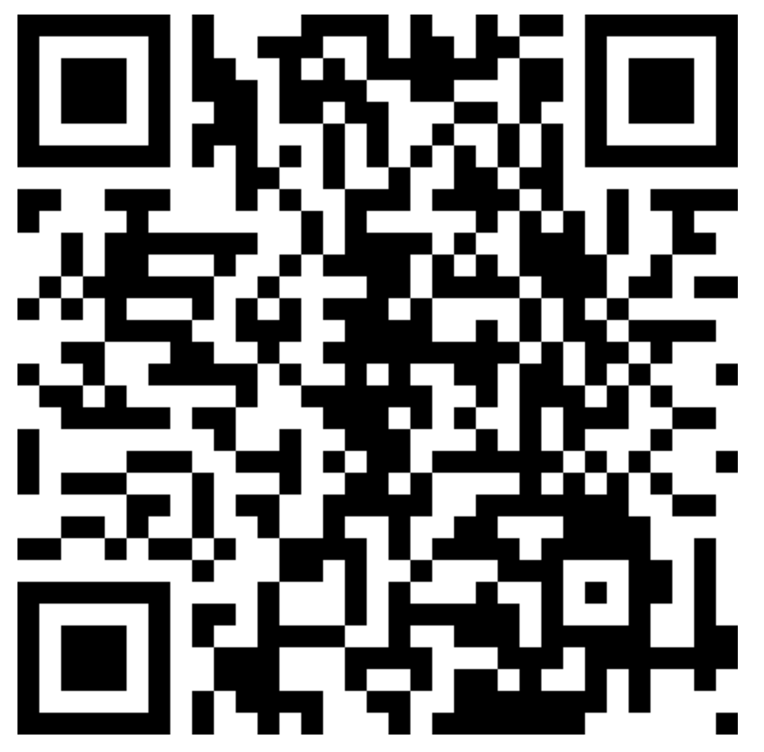
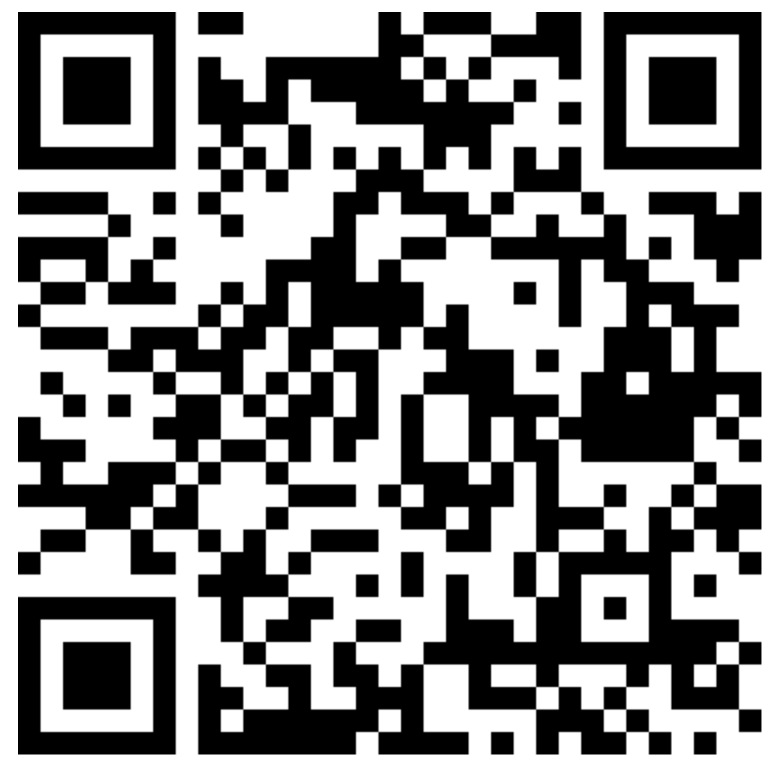

Attendance & Resources
Attending sessions is not mandatory but highly recommended.
Attendance is not assessed.
Any questions? Email me: harry.wang1@monash.edu
Also find the drive to receive the weekly slides: https://tinyurl.com/FIT9136-PASS
Monday 2-3pm
Tuesday 9-10am
Tuesday 4-5pm

Slide 3
Before we go
Test & Assignment
30% & 70%
Test: Test your understanding of Assignments
Assignment: Help you get familiar with main features of programming
Unit Outcomes:
Be familiar with the main feature of programming
Professional documents reading
Data structure - Wk 4
Packages for specific tasks (Data student) - Wk8
Search and sort - Wk9
Efficiency

Slide 4
Agenda
01
Functions - 15 mins
Please input your questions for each practice into the form below:
https://tinyurl.com/PASS-Wk4-Questions
Concept recap + practice + solution
02
Debugging - 30 mins
Concept recap + (practice + solution) * 2
03
Closure speaking - 10 mins
Attendance recording

Slide 5
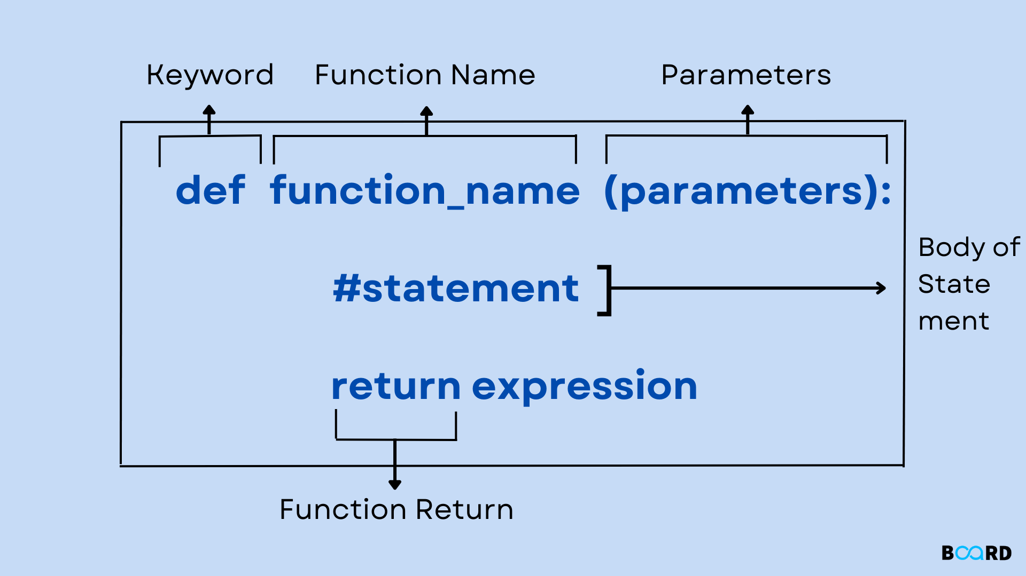
Question form: https://tinyurl.com/PASS-Wk4-Questions
Revision 1 - Functions
Functions In Python, function is a group of statements that perform a certain task.
function_name:
Meaningful
Naming convention
Call Function:
Call other functions
Call itself ?

Slide 6
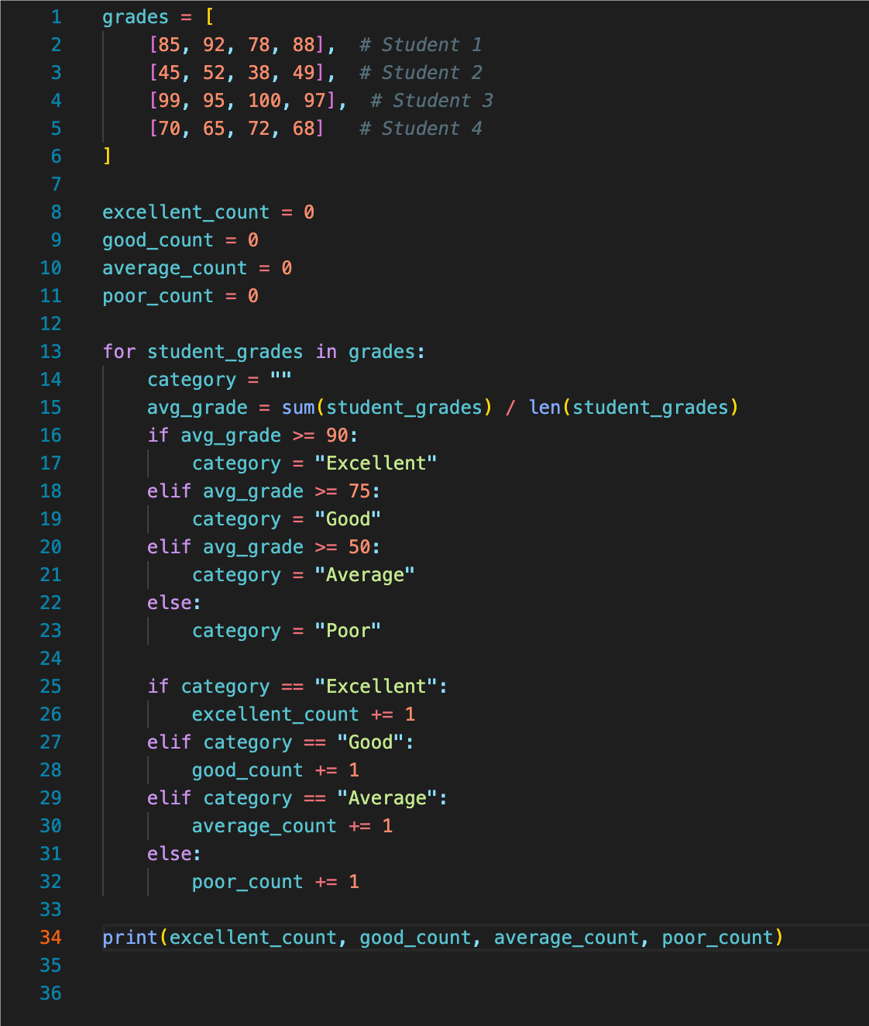
Question form: https://tinyurl.com/PASS-Wk4-Questions
Revision 1 - Problem
Base Code: https://tinyurl.com/FIT9136-PASS /Week 4/revision_questions/function_question_basecode.py
Problem Statement:
You are a teacher who needs to analyze the grades of your students. Each student’s grades for different subjects are represented as a list of integers in a two-dimensional list. Each row in the two-dimensional list represents a student, and each column represents a subject grade. Your task is to write two functions classify_student and analyze_grades that perform the following operations:
1. Classify Students: Classify each student based on their average grade:
• If the average grade is 90 or above, classify as “Excellent”.
• If the average grade is between 75 and 89, classify as “Good”.
• If the average grade is between 50 and 74, classify as “Average”.
• If the average grade is below 50, classify as “Poor”.
2. Generate Summary: Create a summary that includes:
• The total number of students in each category (“Excellent”, “Good”, “Average”, “Poor”).

Slide 7
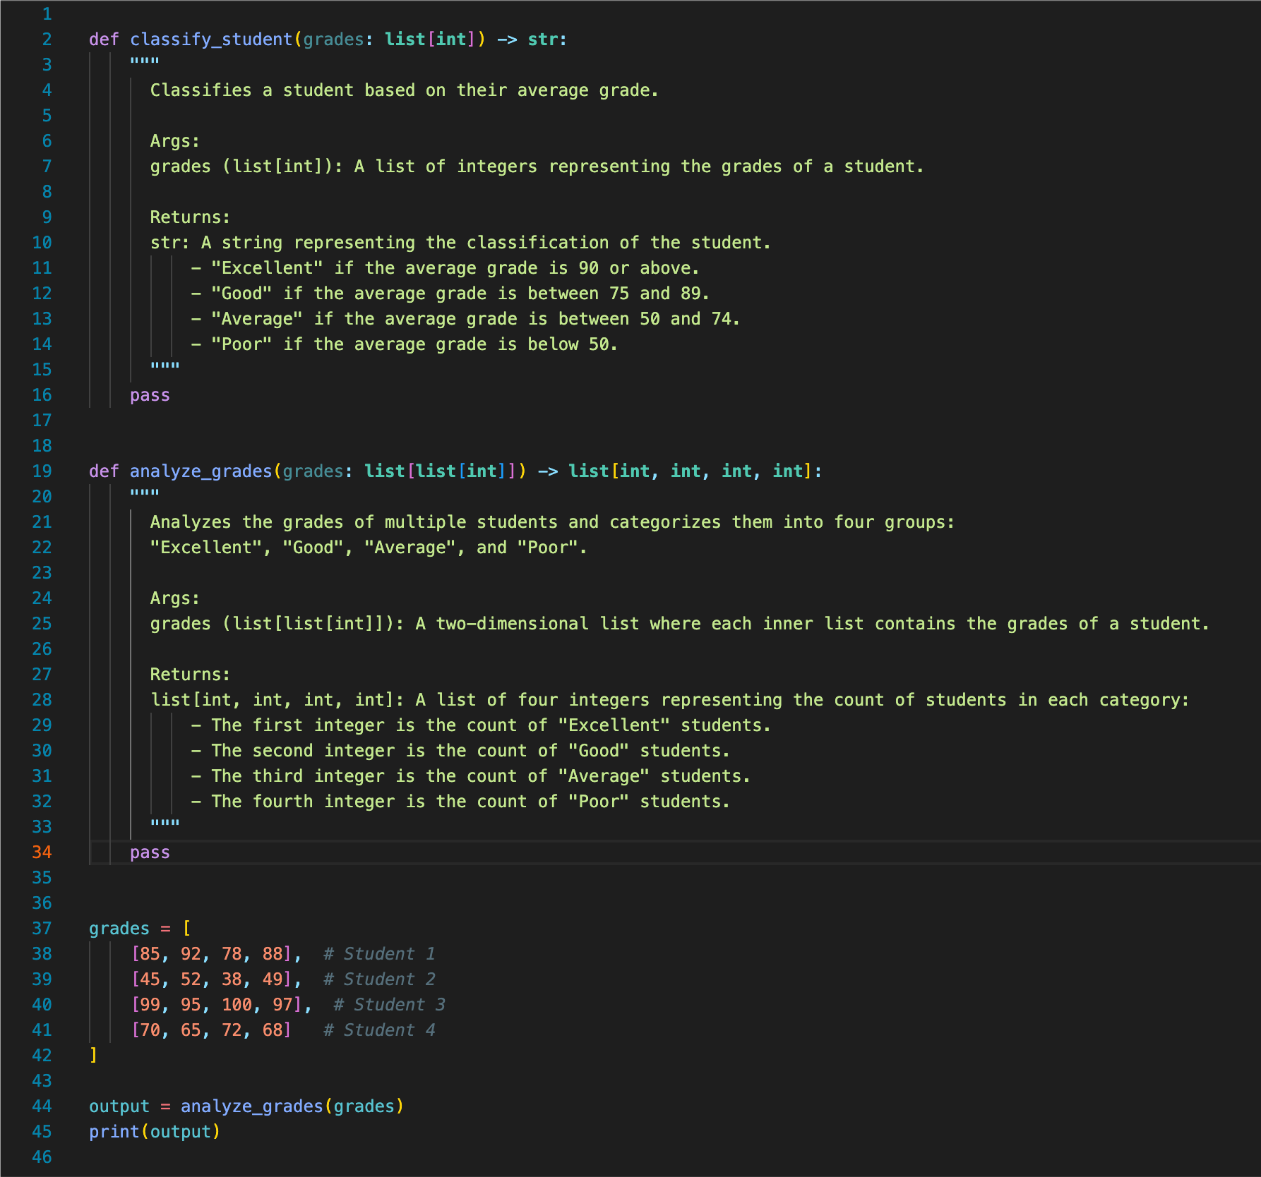
Question form: https://tinyurl.com/PASS-Wk4-Questions
Revision 1 - Problem
Base Code: https://tinyurl.com/FIT9136-PASS /Week 4/revision_questions/function_question_template.py
Tasks:
Copy and paste the code template to your local coding env
Complete the function

Slide 8
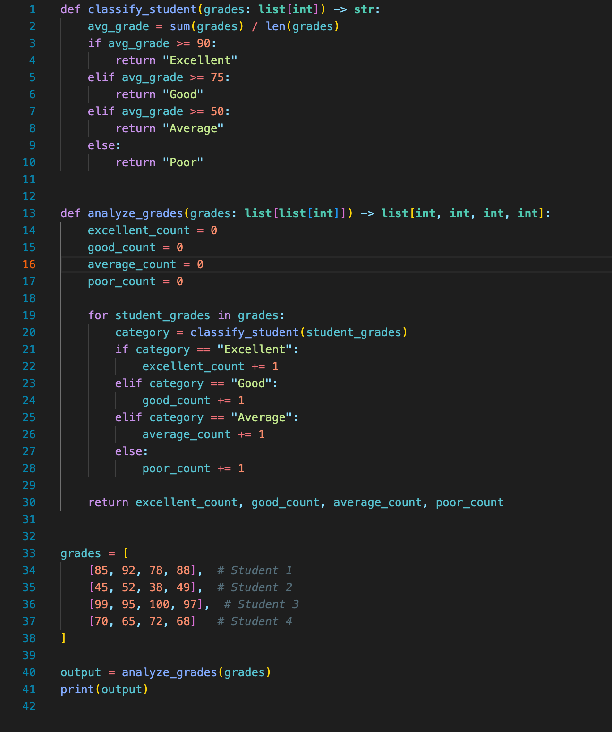
Revision 1 - Solution
Insights:
A function can call other functions
Questions:
Could you print out the value of poor_count outside the function?
Question form: https://tinyurl.com/PASS-Wk4-Questions

Slide 9
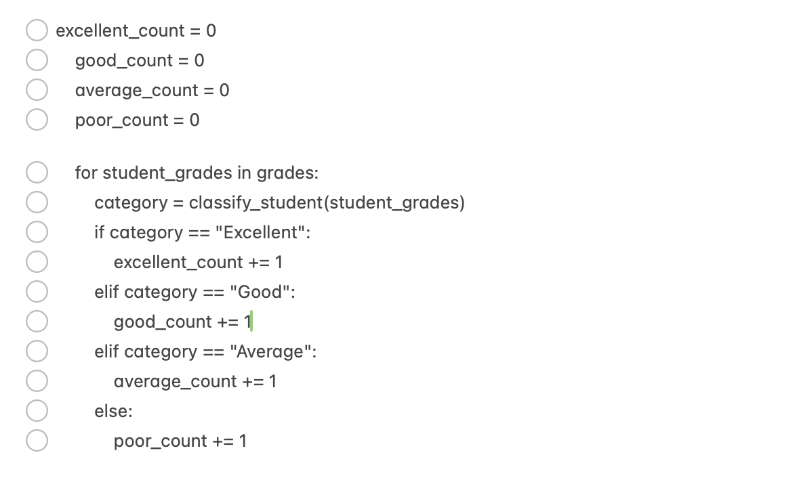
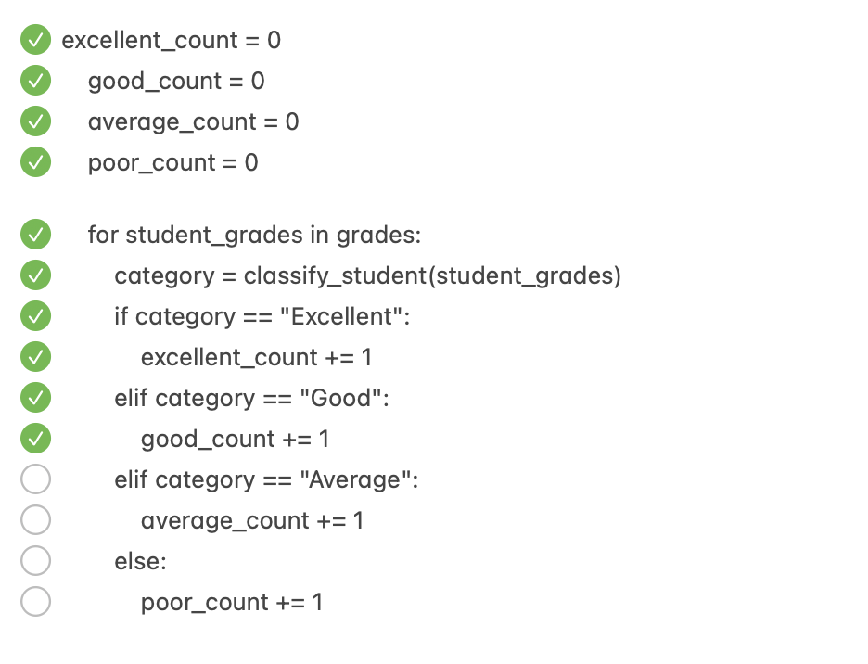
Question form: https://tinyurl.com/PASS-Wk4-Questions
Revision 2 - debugging
Debugging:
Flow of execution

Slide 10
Question form: https://tinyurl.com/PASS-Wk4-Questions
Revision 2 - debugging
Errors:
Syntax error
When the code violates the syntax rules of the Python language.
Runtime error
When the code contains operations that are not executable, leading to an error during program execution.
Semantic error
When the code runs without crashing but produces incorrect results because the logic is wrong.

Slide 11
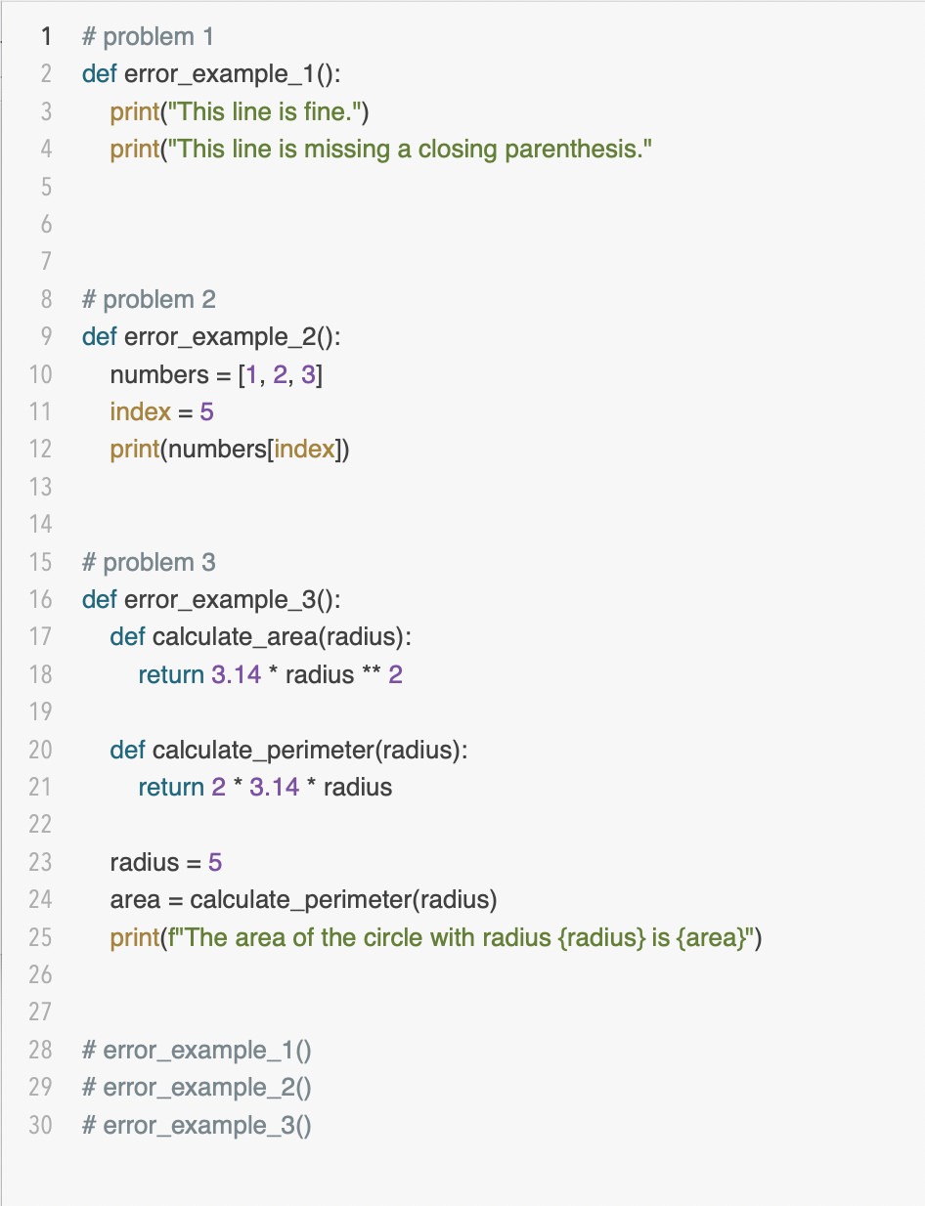
Question form: https://tinyurl.com/PASS-Wk4-Questions
Revision 2 - Problem 1
Base Code: https://tinyurl.com/FIT9136-PASS /Week 4/revision_questions/debugging_1_question.py
Task:
Copy and paste the code to your local coding env
Find out what type of the error is in each function

Slide 12
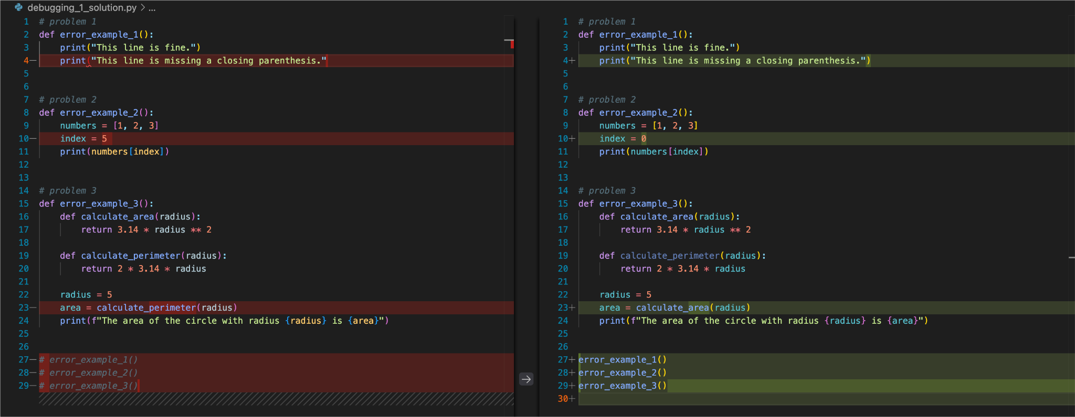
Question form: https://tinyurl.com/PASS-Wk4-Questions
Revision 2 - Problem 1 solution
Answer:
Syntax error
Runtime error
Semantic error

Slide 13
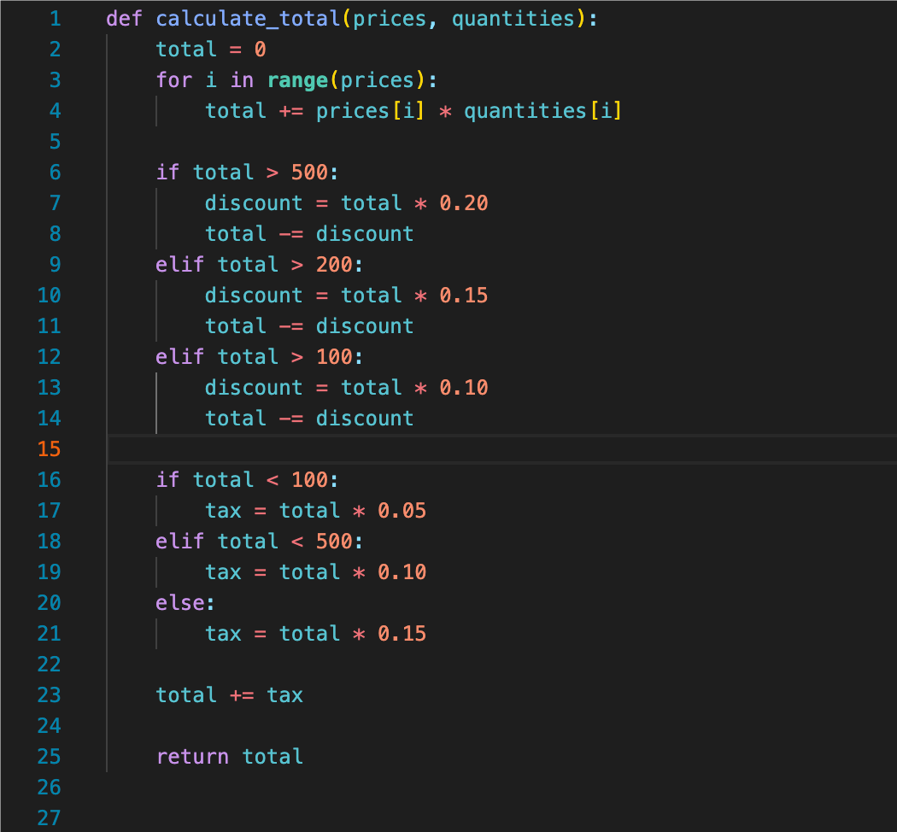
Base Code: https://tinyurl.com/FIT9136-PASS /Week 4/revision_questions/debugging_2_question.py
Revision 2 - Problem 2
Debugging Challenge: Advanced Shopping Cart Total
You are given a function that calculates the total price of items in a shopping cart. The function should apply different discount rates based on the total price before tax, and then add a varying sales tax to the discounted price. However, the code below contains multiple errors. Your task is to debug the code and fix all the errors.
Requirements:
1. Discount:
• If the total price exceeds $500, apply a 20% discount.
• If the total price exceeds $200 but not $500, apply a 15% discount.
• If the total price exceeds $100 but not $200, apply a 10% discount.
• Otherwise, no discount.
2. Sales Tax:
• If the total price after discount is less than $100, apply a 5% sales tax.
• If the total price after discount is between $100 and $500, apply a 10% sales tax.
• If the total price after discount is more than $500, apply a 15% sales tax.

Slide 14
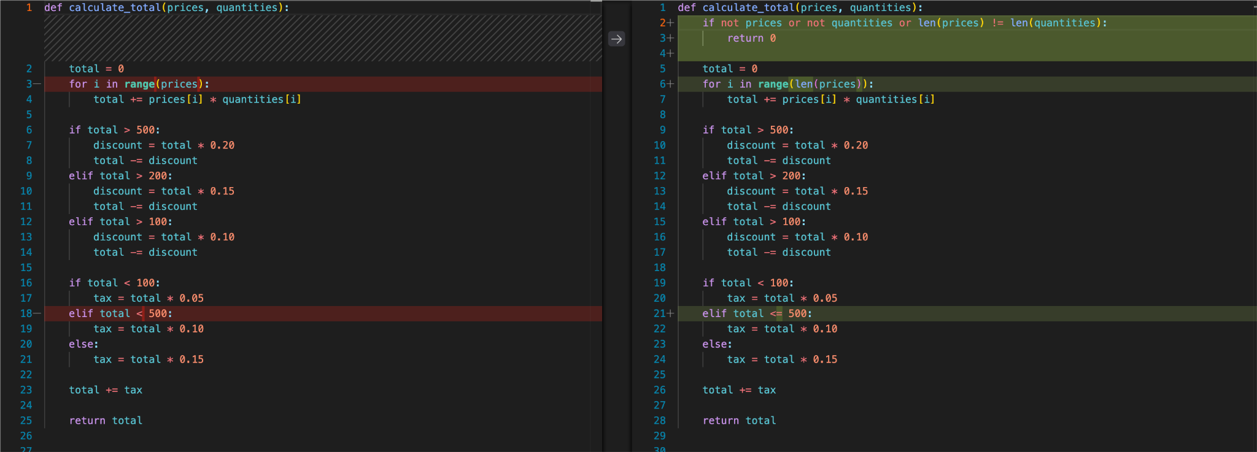
Question form: https://tinyurl.com/PASS-Wk4-Questions
Revision 2 - Problem 2 solution

Slide 15
Attendance & Resources
Attending sessions is not mandatory but highly recommended.
Attendance is not assessed.
Any questions? Email me: harry.wang1@monash.edu
Also find the drive to receive the weekly slides: https://tinyurl.com/FIT9136-PASS
Monday 2-3pm
Tuesday 9-10am
Tuesday 4-5pm

Slide 16
Thank You
12th Aug 2024
CL_33 Innovation Walk, Room C107

Slide 17
Questions & Answers
12th Aug 2024
CL_33 Innovation Walk, Room C107

